Slide 1
Stochastic Modeling
Decisions Under Uncertainty

Slide 2
What You Will Learn
In general you will learn a framework to make decisions under uncertainty. Specifically,
Learn how to use the Expected Value and Decisions Trees to evaluate different alternatives.
Learn how to apply Bayes’ Theorem to correctly update the probabilities in your model.
Learn how to model different Risk Profiles.

Slide 3
Expected Value

Slide 4
Expected Value
When we think about decisions, we face uncertainty.
Ex: weather, traffic, restaurant quality, our mood, etc.
Our objective is to develop a model where decisions interact with probabilities and outcomes. This framework will help us make better decisions on average.

Slide 5
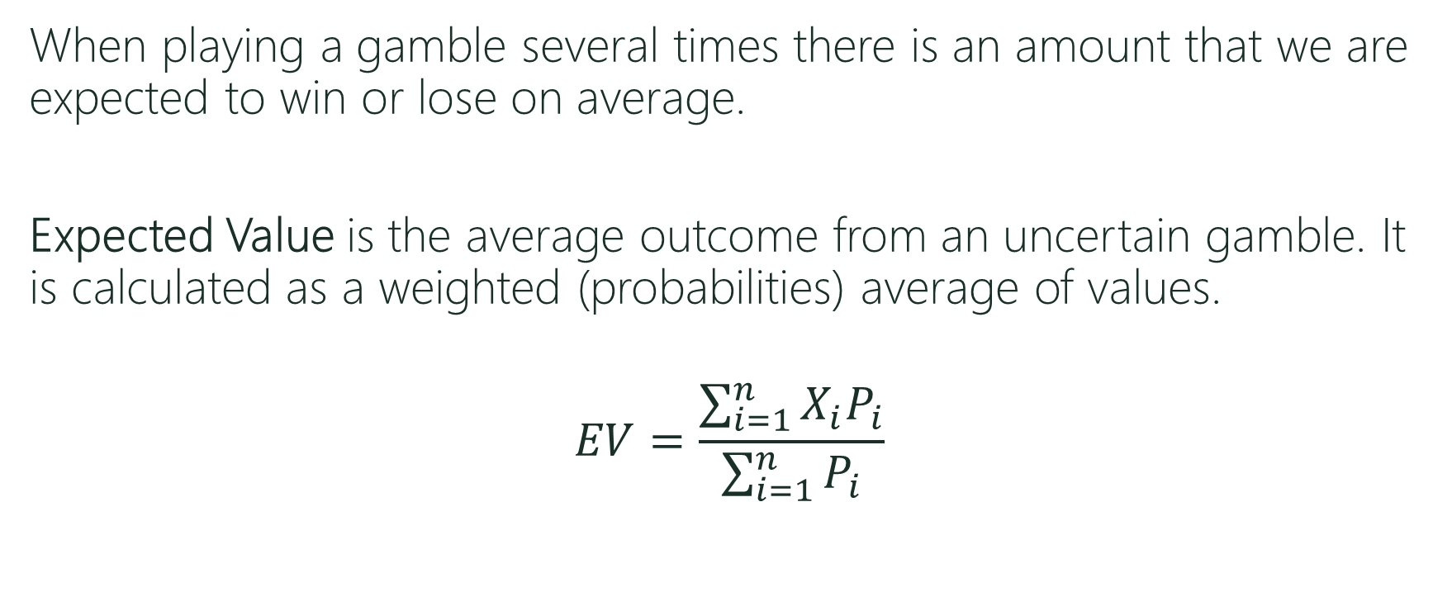
Expected Value
When playing a gamble several times there is an amount that we are expected to win or lose on average.
Expected Value is the average outcome from an uncertain gamble. It is calculated as a weighted (probabilities) average of values.
$$EV=\frac{\sum_{i=1}^{n}{X_{i}P_{i}}}{\sum_{i=1}^{n}{P_{i}}}$$
Values
Probabilities

Slide 6
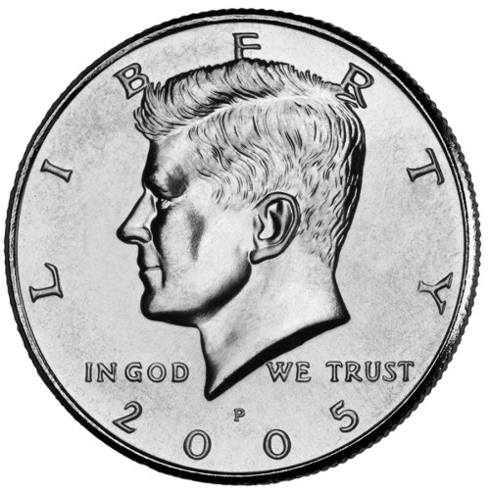

Expected Value
Player A wins $1 from B when not matching:
Player A -> Heads Player B -> Tails
Player A -> Tails Player B -> Heads
Player B wins $1 from A when matching:
Player A -> Heads Player B -> Heads
Player A -> Tails Player B -> Tails

Slide 7

Expected Value
Player A
EV = $1*P(Not Match)-$1*P(Match) $EV=\frac{\sum_{i=1}^{n}{X_{i}P_{i}}}{\sum_{i=1}^{n}{P_{i}}}$
EV = $1*1/2-$1*1/2
EV = 0
Player B
EV = $1*P(Match)-$1*P(Not Match)
EV = $1*1/2-$1*1/2
EV = 0

Slide 8
Expected Value
Player A wins $10 from B when not matching:
Player B wins $1 from A when matching:
What is Player A’s EV?
What is Player B’s EV?
Would Player A want to play the game? Would player B want to play the game?
The EV allows us to rank decisions that involve uncertainty.

Slide 9
Decision Trees

Slide 10
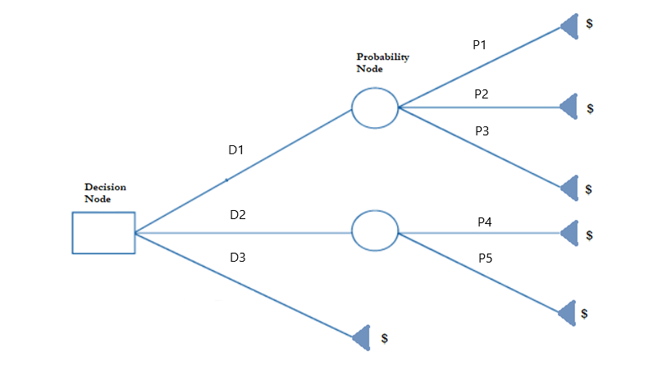
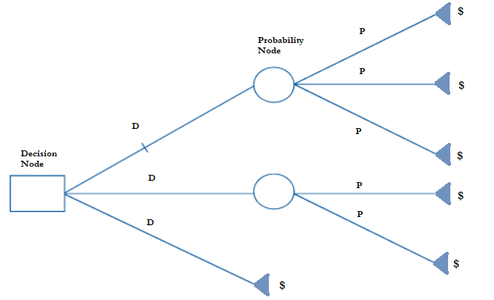
Decisions Trees
D = Decision
P = Probability
$ = Monetary Value

Slide 11
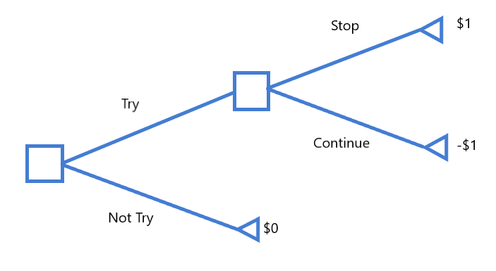
Decision Trees
To try or not to try…

Slide 12
Solving Decision Trees
To solve decision trees we use backward induction:
Start at the end of the tree (right).
Choose the branch that leads to the highest payoff for each of the last decision nodes.
Repeat procedure while moving backwards to the initial node.

Slide 13
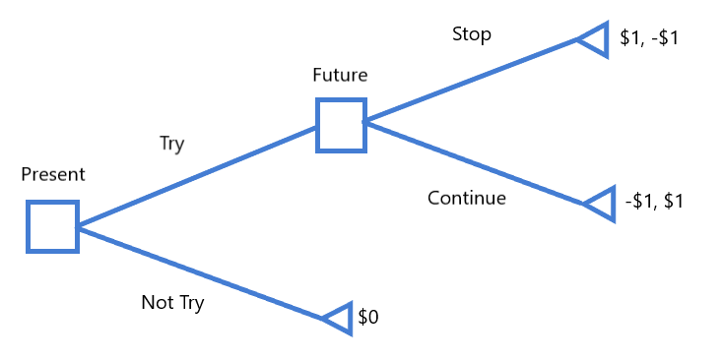
Decision Trees (Interactive)
To try or not to try…

Slide 14
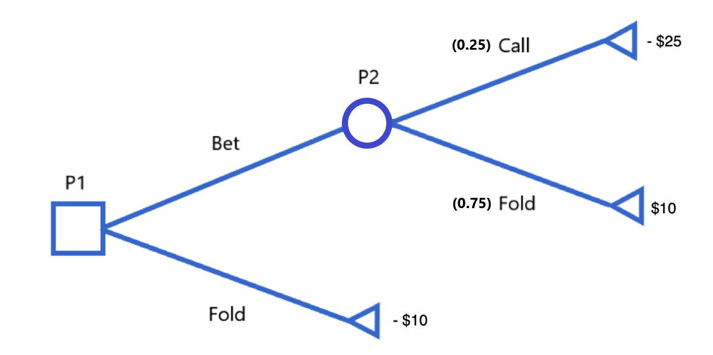
Decision Trees (Uncertainty)
Bluffing in Poker with a Losing Hand…

Slide 15
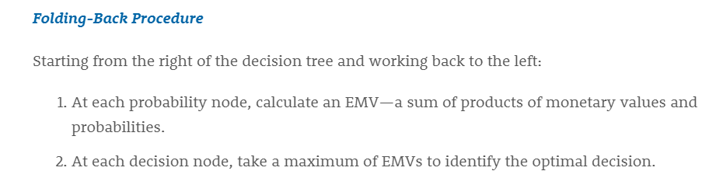
Decision Trees (Uncertainty)
To solve decision trees with uncertainty use the folding-back procedure:

Slide 16
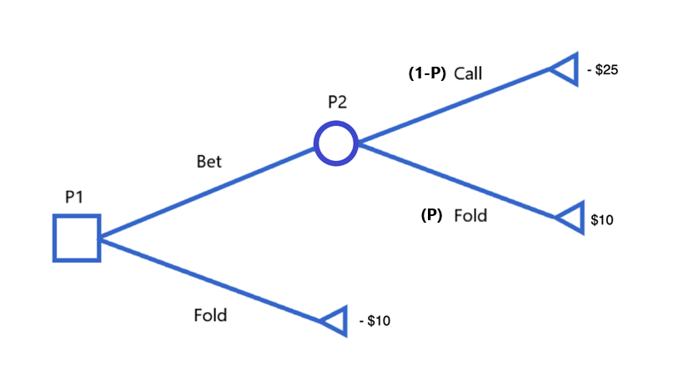
Decision Trees (Uncertainty)
When to bluff with a Losing Hand?

Slide 17
Assigning Probabilities
Classical Method: The classical method of assigning probabilities is appropriate when all the experimental outcomes are equally likely. If n experimental outcomes are possible, a probability of 1/n is assigned to each experimental outcome.
Subjective: The subjective method of assigning probabilities is most appropriate when one cannot realistically assume that the experimental outcomes are equally likely and when little relevant data are available.
Empirical: The empirical method of assigning probabilities is appropriate when data are available to estimate the proportion of the time the experimental outcome will occur if the experiment is repeated a large number of times.

Slide 18
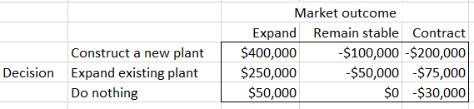
Decision Trees (Example)
Carlisle Tire and Rubber, Inc., is considering expanding production to meet potential increases in the demand for one of its tire products. Carlisle’s alternatives are to construct a new plant, expand the existing plant, or do nothing in the short run. The market for this tire product may expand, remain stable, or contract. Carlisle’s marketing department estimates the probabilities of these market outcomes to be 0.35, 0.35, and 0.30, respectively. What would you recommend Carlisle to do to meet demand?

Slide 19
Decision Trees (Uncertainty)
We can solve this problem several ways:
Drawing a decision tree by hand and using the folding-back procedure
Using an Excel spreadsheet

Slide 20
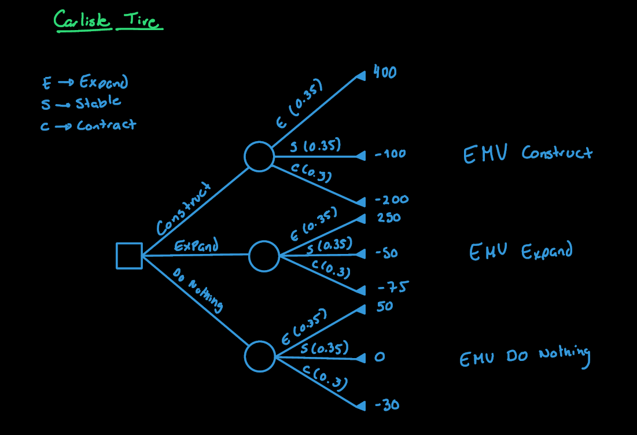

Slide 21
Decision Trees (Example 2)
The Newtown Art Gallery has a valuable painting that it wishes to sell at auction. There will be three bidders for the painting. The first bidder will bid on Monday, the second on Tuesday, and the third on Wednesday. Each bid must be accepted or rejected that same day. Newton Art Gallery can decide to not sell at the auction and instead accept an offer of $900,000. What should NAG do?
 | Probabilities
Amount of Bid | Bidder 1 | Bidder 2 | Bidder 3
$1,000,000.00 | 0 | 0 | 0.7
$2,000,000.00 | 0.5 | 0.9 | 0
$3,000,000.00 | 0.5 | 0 | 0
$4,000,000.00 | 0 | 0.1 | 0.3

Slide 22
Decision Trees (Example 3)
A local energy provider offers a landowner $180,000 for the exploration rights to natural gas on a certain site and the option for future development. This option, if exercised, is worth an additional $1,800,000 to the landowner, but this will occur only if natural gas is discovered during the exploration phase. The landowner, believing that the energy company’s interest in the site is a good indication that gas is present, is tempted to develop the field herself. To do so, she must contract with local experts in natural gas exploration and development. The initial cost for such a contract is $300,000, which is lost forever if no gas is found on the site. If gas is discovered, however, the expectation is that the land will yield a net profit of $6,000,000. The probability of finding gas on this site is 60%.
Should the landowner make a deal with the energy provider?
How much should the energy provider pay the landowner to convince her to give them the right for exploration?
Is it better to increase the offer to the landowner via the offer or by sharing more of the profits?

Slide 23
Laws of Probability

Slide 24
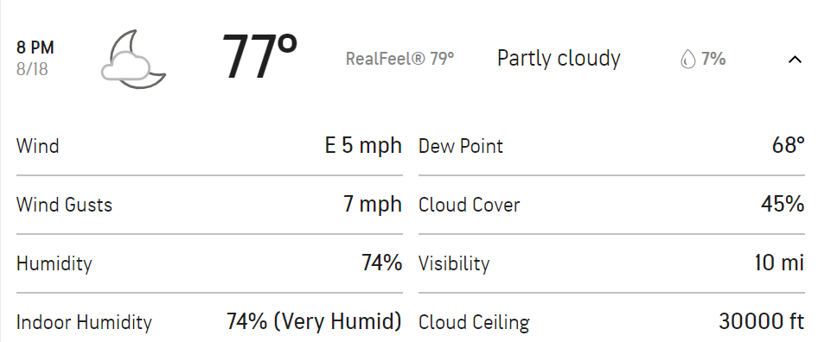
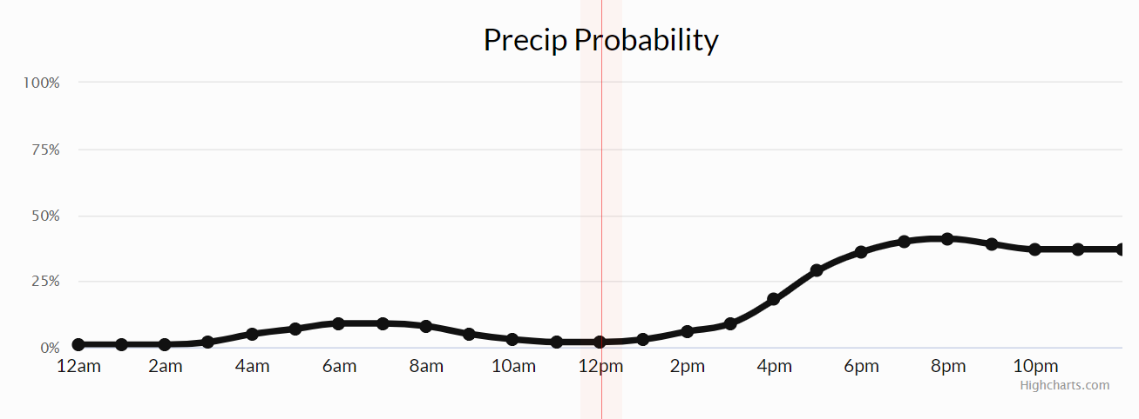
Probability Review
First Law of Probability: The probability of an event is a number between zero and one. 0 -> Certain to not occur. 1 -> Certain to occur.

Slide 25
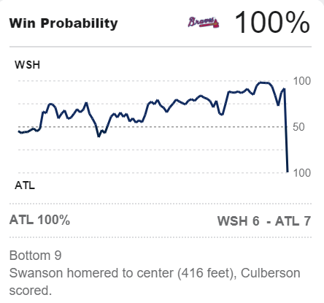
Probability Review
2nd: 3-2
6th: 5-3
New information affects probabilities! Events and Time.

Slide 26
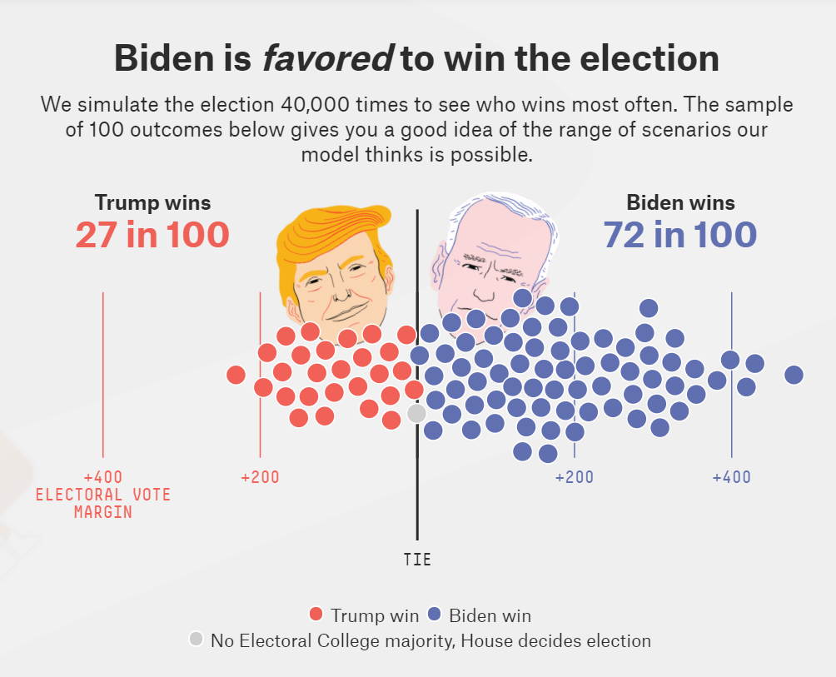
Probability Review
When information is limited, we can use simulation to approximate probabilities!
Notes:
https://projects.fivethirtyeight.com/2020-election-forecast/

Slide 27
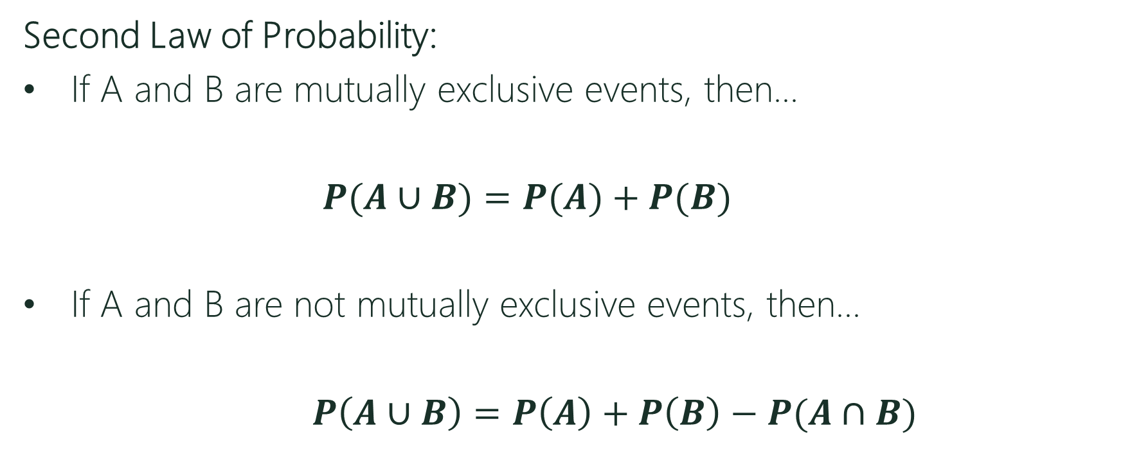
Probability Review
Second Law of Probability:
If A and B are mutually exclusive events, then…
$P(A∪B)=P(A)+P(B)$
If A and B are not mutually exclusive events, then…
$P\left(A∪B\right)=P\left(A\right)+P\left(B\right)−P(A∩B)$
Union

Slide 28
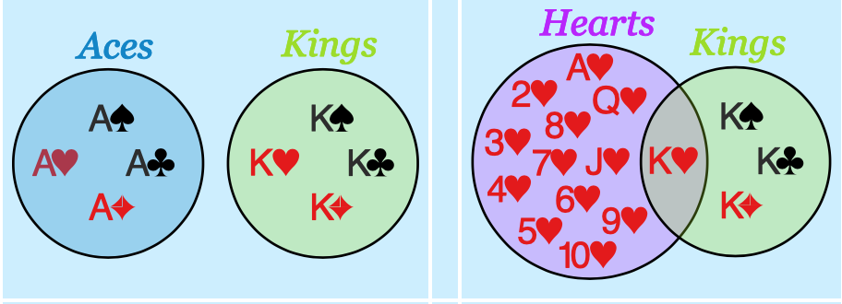
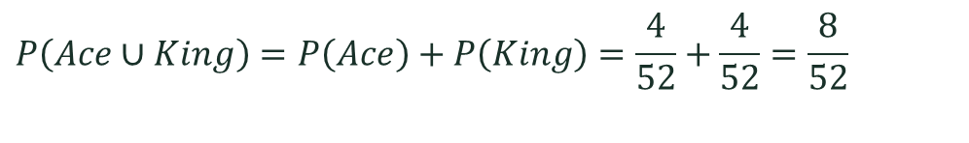
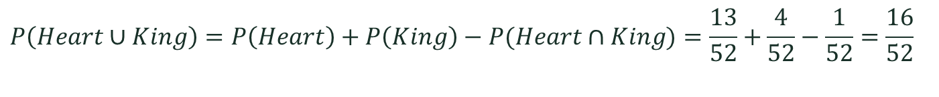
Probability Review
A standard deck of card has 52 cards.
OR
Mutually Exclusive
Not Mutually Exclusive
$$P\left(Ace∪King\right)=P\left(Ace\right)+P\left(King\right)=\frac{4}{52}+\frac{4}{52}=\frac{8}{52}$$
$$P\left(Heart∪King\right)=P\left(Heart\right)+P\left(King\right)−P(Heart∩King)=\frac{13}{52}+\frac{4}{52}−\frac{1}{52}=\frac{16}{52}$$

Slide 29




Probability Review
Third Law of Probability: For events A and B:
$$P\left(A|B\right)=\frac{P\left(A∩B\right)}{P\left(B\right)}$$
Intersection
Given
$$=\frac{8/100}{20/100}$$
A
B
10
8
12
$$P\left(A|B\right)=8/20$$
70
$$A∩B$$

Slide 30

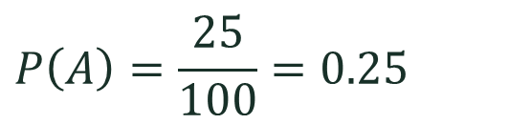
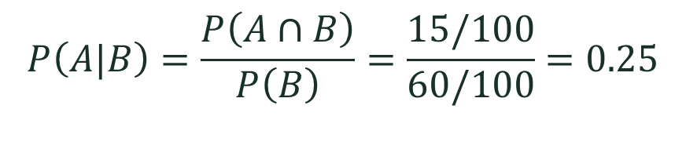

Probability Review
Fourth Law of Probability: If A and B are independent then
$$P(A|B)=P(A)$$
A
B
$$P\left(A|B\right)=\frac{P\left(A∩B\right)}{P\left(B\right)}=\frac{15/100}{60/100}=0.25$$
10
15
45
$$P\left(A\right)=\frac{25}{100}=0.25$$
30
$$A∩B$$

Slide 31
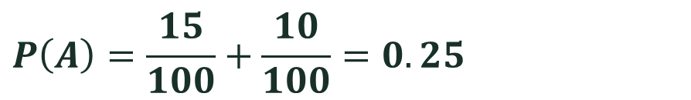





Probability Review
Law of Total Probability:
$P\left(A\right)=P\left(A|B\right)P\left(B\right)+P\left(A|B^{c}\right)P(B^{c})$
Complement
$$B$$
$$B^{c}$$
$$A$$
By using the third law…
$$P\left(A\right)=P\left(A∩B\right)+P(A∩B^{c})$$
$$P\left(A\right)=\frac{15}{100}+\frac{10}{100}=0.25$$
$$P\left(A∩B\right)$$
$$P(A∩B^{c})$$

Slide 32
Bayes’ Theorem

Slide 33
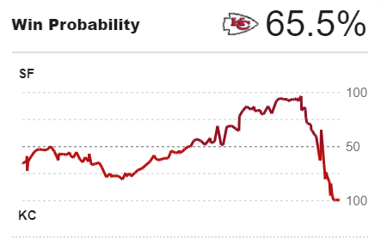



Bayes’ Theorem
How does new information affect our prior expectations?
Prior probabilities
Information observed
Posterior probabilities
Bayes’ Theorem
$$\frac{P\left(B|A\right)}{P(B)}$$
$$P(A)$$
$$=P\left(A|B\right)$$
Prior
Posterior
Informativeness
Notes:
Law of total probability in the denominator. Can be written as P(AnB)+P(AnB’) by using the law of total probability.
The prior is what you believed about A before having encountered a new and relevant piece of information B.
The quotient of the likelihood divided the marginal probability of the new piece of information indexes the informativeness of the new information for your beliefs about B
The posterior is what you believe (or ought to, if you are rational) about B after having encountered a new and relevant piece of information.

Slide 34
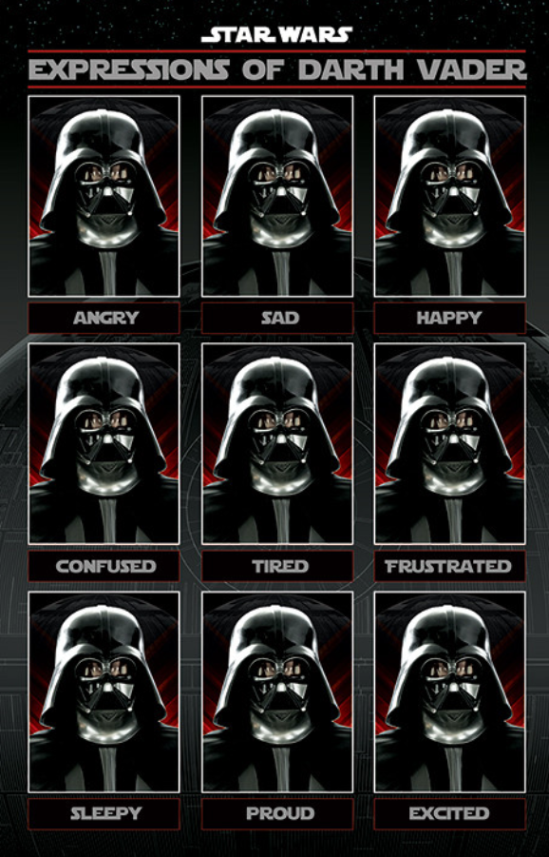
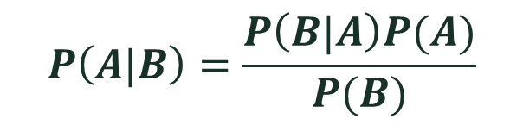
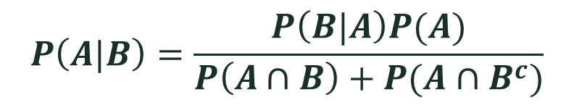
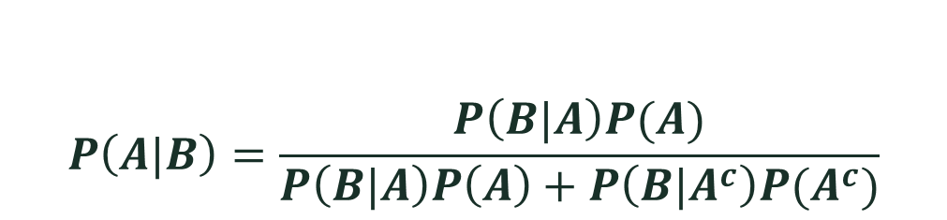
Bayes’ Theorem
EXPRESSIONS OF BAYES…
$$P\left(A|B\right)=\frac{P\left(B|A\right)P(A)}{P(B)}$$
$$P\left(A|B\right)=\frac{P\left(B|A\right)P(A)}{P\left(B|A\right)P\left(A\right)+P\left(B|A^{c}\right)P(A^{c})}$$
$$P\left(A|B\right)=\frac{P\left(B|A\right)P(A)}{P\left(A∩B\right)+P(A∩B^{c})}$$
...........

Slide 35
Bayes’ Theorem (Example)
Probability of having a kind of cancer P(C)=1%
Probability of testing positive when not having cancer (NC)
P(+|NC)=10% False Positive (T1) P(-|NC)=90%
Probability of testing negative when having the disease (C)
P(-|C)=5% False Negative (T2) P(+|C)=95%
What is the probability of having the disease given that the test was positive?
P(C|+)=?

Slide 36






Bayes’ Theorem
P(C)=1% P(+|NC)=10% P(-|NC)=90% P(-|C)=5% P(+|C)=95%
$$\frac{P\left(C\right)P(+|C)}{P(+)}$$
$$P\left(C|+\right)=$$
Using Bayes’ Theorem…
Substituting…
$$0.01∗8.7558=8.75\%$$
$$P\left(+\right)=$$
Using the Law of Total Prob…
$$P\left(+|C\right)P\left(C\right)+P\left(+|NC\right)P(NC)$$
Substituting…
0.95*0.01$+0.1∗0.99=$
0.1085
Getting a positive test is relatively rare and the test has high recall.

Slide 37
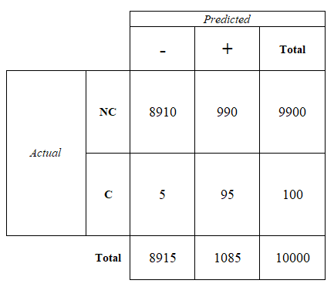
Bayes’ Theorem
Let’s assume a sample of 10,000…
Marginal P(C)=1% P(NC)=99% P(+)=10.85% P(-)=89.15% Conditional P(+|NC)=10% P(-|NC)=90% P(-|C)=5% P(+|C)=95% P(C|+)=8.75% P(NC|+)=91.25% P(C|-)=95% P(NC|-)=95%
Accuracy
90.05%
Precision
8.75%
Recall
95%
Specificity
90%
Type I
10%
Type II
5%

Slide 38




Bayes’ Theorem (Example)
Suppose you are tested to see if you have a rare disease. Assume that if you have the disease, your test will always come back positive, but if you do not have the disease, there is still a 0.001 chance that you will test positive. In reality, only 1 of 10,000 people have the disease. Your doctor calls and says that you have tested positive. He is sorry but there is a 99.9% (1−0.001) chance that you have the disease. Is he correct? What is the actual probability that you have the disease?
$$P(+|D)$$
$$P(+|ND)$$
$$P(D)$$
$$P(D|+)$$

Slide 39
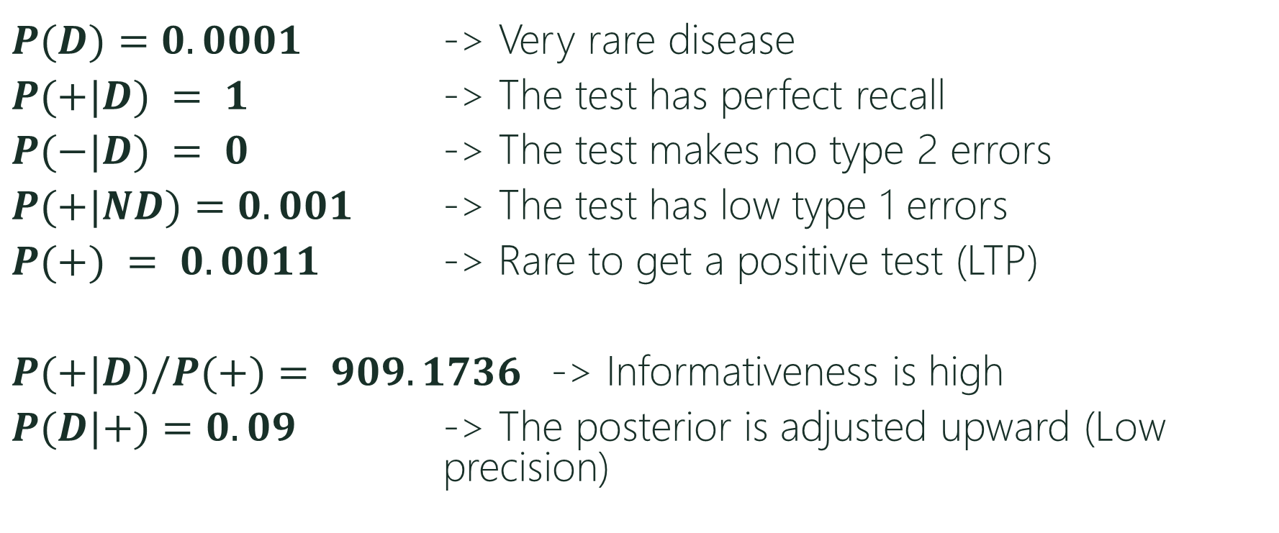
Bayes’ Theorem
$P(D)=0.0001$ -> Very rare disease
$P(+|D) = 1$ -> The test has perfect recall
$P(−|D) = 0$ -> The test makes no type 2 errors
$P(+|ND)=0.001$ -> The test has low type 1 errors
$P(+) = 0.0011$ -> Rare to get a positive test (LTP)
$P(+|D)/P(+)= 909.1736$ -> Informativeness is high
$P(D|+)=0.09$ -> The posterior is adjusted upward (Low precision)

Slide 40




Bayes’ Theorem (Example)
If you believe that 3% of graduate students are enrolled in computer science, and you also believe that the description of Arun is 4 times more likely for a graduate student in that field than in other fields, then Bayes’ rule says you must believe that the probability that Arun is a computer scientist to be…
$$P(CS|D)=P(CS)∗\frac{P\left(D | CS\right)}{P\left(D\right)}$$
$$P(CS)=3\%$$
$$=11.009\%$$
Using Bayes’ Theorem…
$$P(D|CS)=4∗P(D|NCS)$$
Using Law of Total Probability…
$$P\left(D\right)=P\left(D | CS\right)P\left(CS\right)+P\left(D | NCS\right)P(NCS)$$
$$P\left(D\right)=27.25\%P\left(D | CS\right)$$

Slide 41



Example of Updating Probabilities in Decision Trees
$$P\left(S\right)=30\%$$
$$P\left(+|W\right)=10\%$$
$$P\left(−|S\right)=20\%$$
Caroline Janes is the marketing manager for a consumer products company that is considering whether to produce a new automatic dishwashing detergent called “Suds-Away.” The market for Suds Away will either be weak or it will be strong. If the market is strong, the company will make $18 million on Suds-Away, but if the market is weak the company will lose $8 million. Based on a combination of experience and intuition, Caroline has estimated that there is a 30% chance that the market for Suds-Away will be strong. Prior to deciding whether or not to produce Suds-Away, Caroline can conduct a nationwide market survey test of Suds-Away. The cost of the market survey would be $2.4 million. Such a market survey is not perfect. Past results indicate that if the market is weak, there is a 10% chance that the test will be positive. Also, if the market is strong, there is a 20% chance that the test will be negative. What should Caroline do?

Slide 42
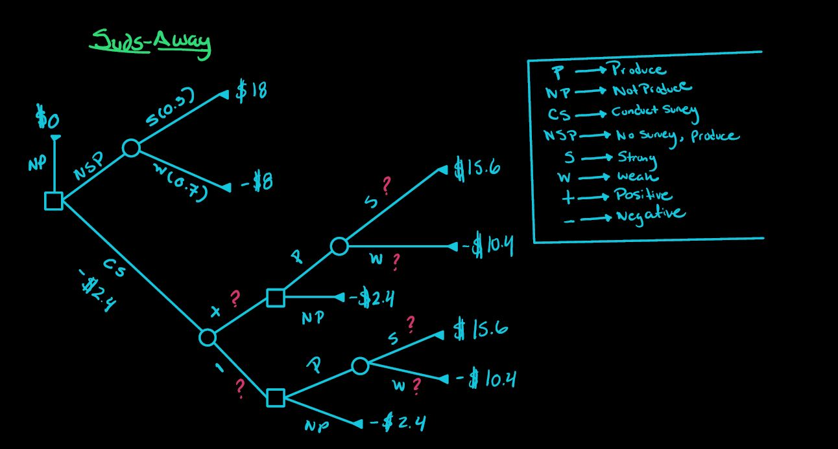



$$P\left(S\right)=30\%$$
$$P\left(+|W\right)=10\%$$
$$P\left(−|S\right)=20\%$$

Slide 43
The Value of Information
The Expected Value of Information (EVI):
The increase in the expected value that the information generates (i.e. is what we gain by getting the information for free).
$$EVI=EMV with \left(free\right) information −EMV without information$$

Slide 44
The Value of Information
The Expected Value of Free and Perfect Information:
The increase in the expected value that the perfect information generates (i.e. is what we gain by getting the free and accurate information).
$$EVPI=EMV with \left(free\right) perfect information −EMV without information$$

Slide 45
Risk Profiles

Slide 46
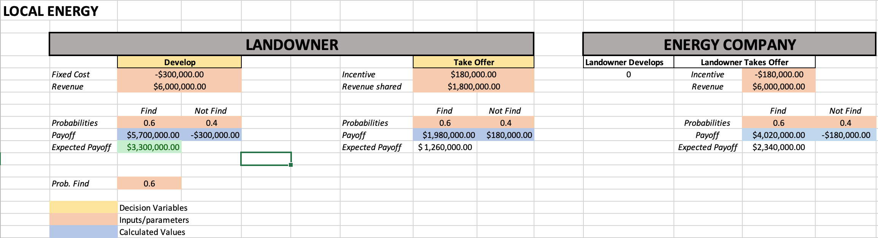
Risk Aversion (Back to the Landowner Problem)
How will this problem change if the Landowner doesn’t like risk? What if the she likes risk?

Slide 47
Risk Aversion
People that refuse fair gambles (recall matching pennies game) or would pay to avoid risk are called risk averse. Losing affects the person more than winning.
Since expected profits do not capture risk profiles, we use utility to measure risk aversion.
Utility: The pleasure or satisfaction of engaging in economic activity.

Slide 48
Risk Aversion (The value of $3 more dollars)
Level 1 ($1-$2 per day): You start on level 1 with $1 per day. Your five children have to spend hours walking barefoot with your single plastic bucket, back and forth, to fetch water from a dirty mud hole an hour’s walk away. On their way home they gather firewood, and you prepare the same gray porridge that you’ve been eating, every day, for your whole life- except during the months when the meager soil yielded no crops, and you went to bed hungry. One day your youngest daughter develops a nasty cough. Smoke from the indoor fire is weakening her lungs. You can’t afford antibiotics. This is extreme poverty.
Notes:
Factfulness, by Hans Rosling.

Slide 49
Risk Aversion (The value of $3 more dollars)
Level 2 ($2-$8 per day): You earn $4 per day. What are you going to do with all this extra money? Now you can buy food that you didn’t grow yourself and you can afford chickens, which means eggs. You save some money and buy sandals for you children, and a bike, and more plastic buckets. Now it only takes you half an hour to fetch water for the day you buy a gas stove so your children can attend school instead of gathering wood. When there is power, they do their homework under a bulb. But the electricity is too unstable for a freezer. You save up for a mattress, so you don’t have to sleep on a mud floor. Life is much better now, but still uncertain. A single illness and you would have to sell most of your possessions to buy medicine. That will throw you back to Level 1 again.

Slide 50
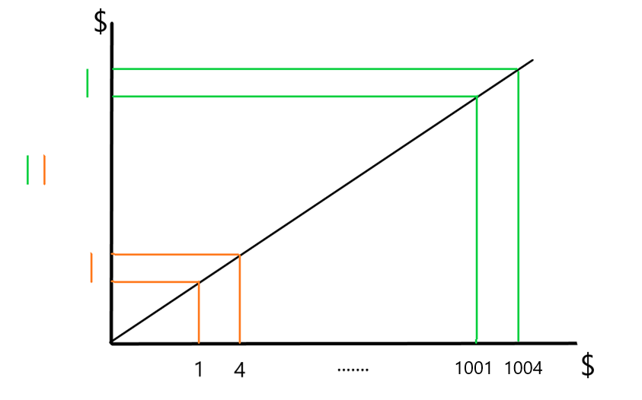
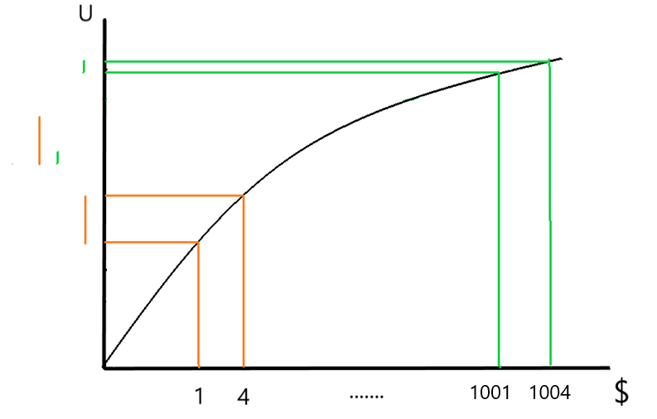
Risk Aversion

Slide 51
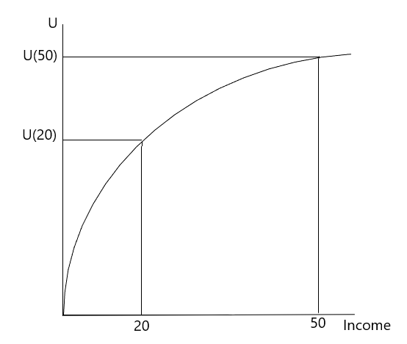
Risk Aversion
Decreasing Marginal Utility: The increase in utility from an extra dollar of income decreases.
The utility function is concave. U(I).
We model risk aversion by using log, exp, sqrt, and other concave functions.

Slide 52
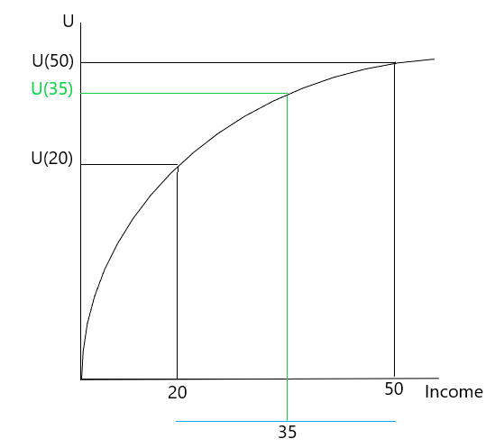
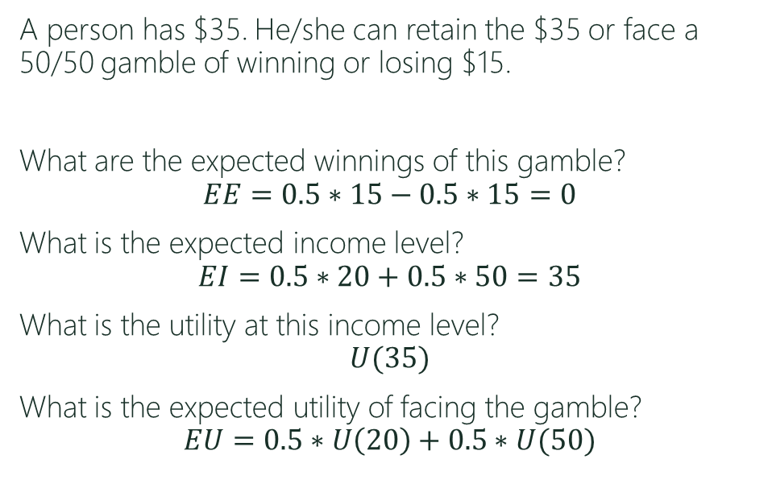
Risk Aversion
A person has $35. He/she can retain the $35 or face a 50/50 gamble of winning or losing $15.
What are the expected winnings of this gamble?
$$EE=0.5∗15−0.5∗15=0$$
What is the expected income level?
$$EI=0.5∗20+0.5∗50=35$$
What is the utility at this income level?
$$U(35)$$
What is the expected utility of facing the gamble?
$$EU=0.5∗U\left(20\right)+0.5∗U(50)$$
EU

Slide 53
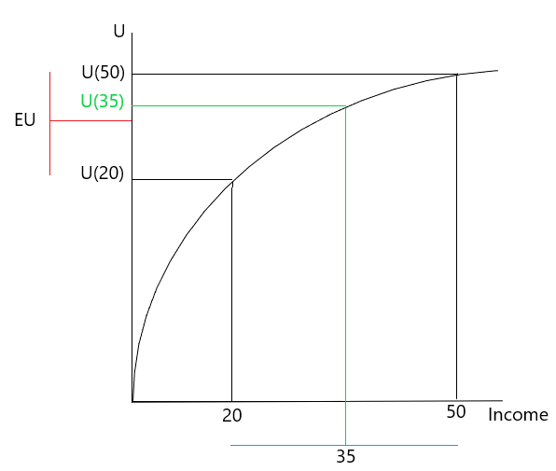
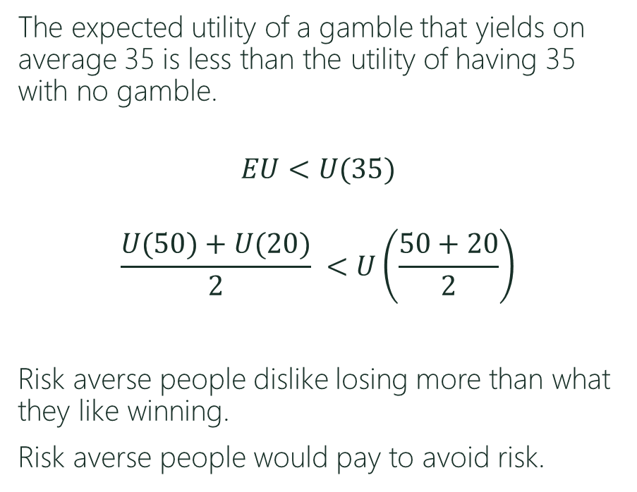
Risk Aversion
The expected utility of a gamble that yields on average 35 is less than the utility of having 35 with no gamble.
$$EU<U(35)$$
$$\frac{U(50)+U(20)}{2} <U\left(\frac{50+20}{2}\right)$$
Risk averse people dislike losing more than what they like winning.
Risk averse people would pay to avoid risk.

Slide 54
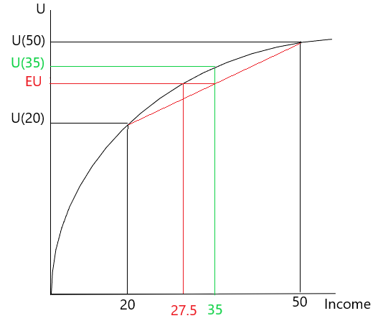
Risk Aversion (Certainty Equivalent)
Certainty Equivalent: Sure dollar
Amount that the person would
accept to avoid the gamble.
How much would this person
be willing to pay to avoid the risk?
Notes:
Pay 7.5 to avoid the risk

Slide 55
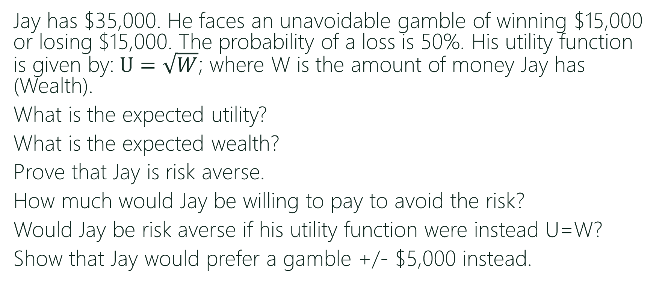
Risk Aversion (Example)
Jay has $35,000. He faces an unavoidable gamble of winning $15,000 or losing $15,000. The probability of a loss is 50%. His utility function is given by: $U=\sqrt{W}$; where W is the amount of money Jay has (Wealth).
What is the expected utility?
What is the expected wealth?
Prove that Jay is risk averse.
How much would Jay be willing to pay to avoid the risk?
Would Jay be risk averse if his utility function were instead U=W?
Show that Jay would prefer a gamble +/- $5,000 instead.
Notes:
He would prefer 5000 game

Slide 56
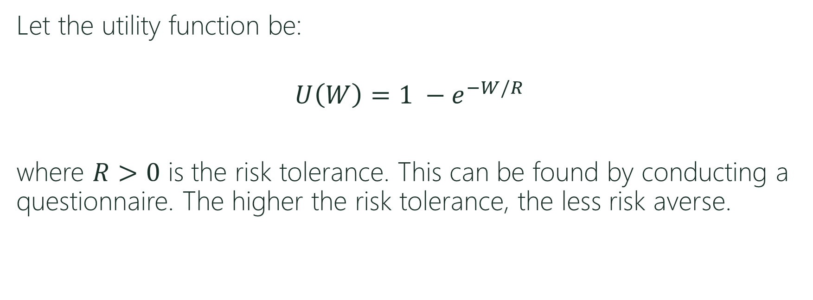
Risk Aversion (Degrees)
Let the utility function be:
$$U\left(W\right)=1 −e^{−W/R}$$
where $R>0$ is the risk tolerance. This can be found by conducting a questionnaire. The higher the risk tolerance, the less risk averse.
Plot the utility function as a function of W and observe what happens to the curve as R changes. Use the plot function in r.
Notes:
https://www.cfainstitute.org/-/media/documents/article/rf-brief/rfbr-v4-n1-1.ashx

Slide 57
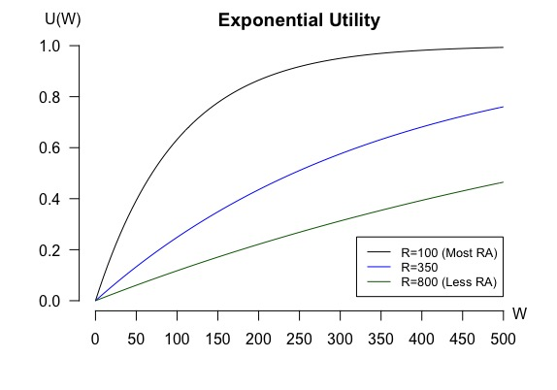
Exponential Utility Plot
Notes:
W<-seq(0,500,5)
U<- function(W,r) {
1-exp(-W/r)
}
r<-c(100,350,800) #The risk tolerance. The higher the less risk averse.
par(mai=c(0.85,0.85,0.4,0.4)) #Set Margins
plot(W,U(W,r[1]),type='l',lwd=1, main="Exponential Utility",xlab="Wealth",
ylab="Utility", axes=FALSE)
axis(side=1, labels=TRUE, at=seq(0,500,by=50),font=1)
axis(side=2, labels=TRUE, at=seq(0,1,by=0.2),font=1,las=1)
lines(W,U(W,r[2]),type='l',col="blue")
lines(W,U(W,r[3]),type='l',col="darkgreen")
legend(320,0.25,legend=c(”r=100 (Most RA)", ”r=350",”r=800 (Less RA)"),
col=c("black","blue", "darkgreen"), lty=1, cex=0.8)

Slide 58
Back To Carlisle Tire.
Carlisle Tire and Rubber, Inc., is considering expanding production to meet potential increases in the demand for one of its tire products. Carlisle’s alternatives are to construct a new plant, expand the existing plant, or do nothing in the short run. The market for this tire product may expand, remain stable, or contract. Carlisle’s marketing department estimates the probabilities of these market outcomes to be 0.35, 0.35, and 0.30, respectively.
Let r=200,000. Does this change the previous recommendation?
What happens to the certainty equivalent as R increases?

Slide 59
Back to the Landowner Problem.
Let R=500,000. Does this change the previous recommendation?
Let R=1,500,000. Is it better for the Company to increase the fixed incentive or the share of revenues to convince the Landowner? Assume the company itself is risk neutral.

